Slide 1
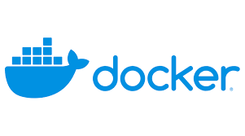
Rohit Vignesh 05/05/22

Slide 2
Introduction Docker Architecture Docker Installation Docker File creation Docker commands
Agenda

Slide 3
Docker enables you to separate your applications from your infrastructure so you can deliver software quickly. It is lightweight and fast. Containers are lightweight and contain everything needed to run the application, so you do not need to rely on what is currently installed on the host. Containers are Isolate the apps from each other. We can run many containers simultaneously on a given host. Containers are great for continuous integration and continuous delivery (CI/CD) workflows. Containers can run on a developer’s local laptop, on physical or virtual machines in a data center, on cloud providers, or in a mixture of environments Advantage of Docker : you can significantly reduce the delay between writing code and running it in production
Docker

Slide 4
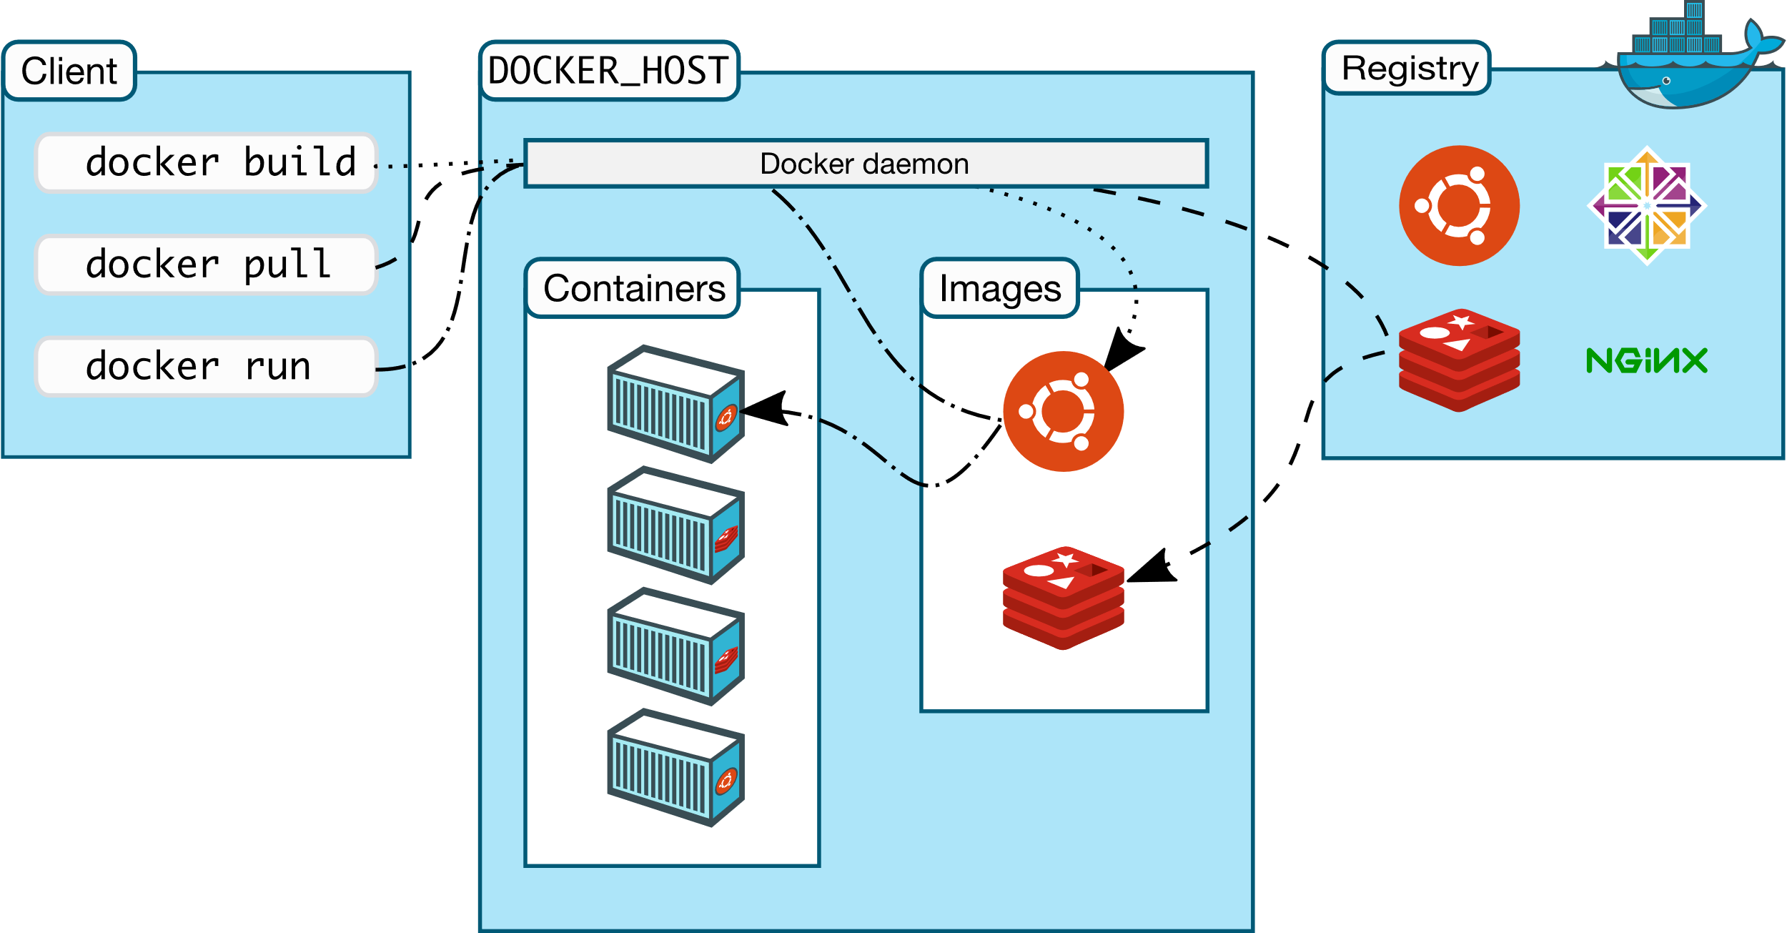
Docker uses a client-server architecture. Docker client -> When we use docker run command , the client sends these commands to Docker daemon (dockerd). Docker client and daemon communicate using a REST API, over UNIX sockets or a network interface Docker daemon -> building, running, and distributing your Docker containers. Manages Docker objects such as images, containers, networks, and volumes. Docker registries -> stores Docker images. Docker Hub is a public registry https://hub.docker.com/ docker pull or docker run commands images are pulled from docker registry. docker push used to push your image to your registry.
Docker Architecture

Slide 5
sudo yum install -y yum-utils device-mapper-persistent-data lvm2 -y sudo yum-config-manager --add-repo https://download.docker.com/linux/centos/docker-ce.repo sudo yum-config-manager --enable docker-ce-edge sudo yum-config-manager --enable docker-ce-test sudo yum install docker-ce -y sudo systemctl start docker sudo docker run hello-world Docker Installation in Windows : https://docs.docker.com/desktop/windows/install/
Docker Installation in Centos7

Slide 6
sudo apt-get update sudo apt-get install ca-certificates curl gnupg lsb-release curl -fsSL https://download.docker.com/linux/ubuntu/gpg | sudo gpg --dearmor -o /usr/share/keyrings/docker-archive-keyring.gpg echo "deb [arch=$(dpkg --print-architecture) signed-by=/usr/share/keyrings/docker-archive-keyring.gpg] https://download.docker.com/linux/ubuntu $(lsb_release -cs) stable" | sudo tee /etc/apt/sources.list.d/docker.list > /dev/null sudo apt-get update sudo apt-get install docker-ce docker-ce-cli containerd.io docker-compose-plugin docker --version
Docker Installation in ubuntu

Slide 7
docker -> list all the docker commands docker --version service docker status -> to check status of docker service docker start -> to start the docker docker pull openjdk -> download from https://hub.docker.com/_/openjdk docker pull hello-world -> download from https://hub.docker.com/_/hello-world docker image history openjdk docker image list -> list all the docker images in below format REPOSITORY TAG IMAGE ID CREATED SIZE openjdk latest 5e28ba2b4cdb 6 days ago 471MB hello-world latest feb5d9fea6a5 7 months ago 13.3kB docker run hello-world -> Verify your docker image pulled from docker hub (hello-world)
Docker Commands

Slide 8
docker login -> In putty, login to docker using docker hub credentials -> Enter the username & password docker ps -a CONTAINER ID IMAGE COMMAND CREATED STATUS PORTS NAMES 078588a7d62c hello-world "/hello" 4 minutes ago Exited (0) 4 minutes ago wizardly_Sutherland docker tag feb5d9fea6a5 rvignesh611/first_app:1.0 REPOSITORY TAG IMAGE ID CREATED SIZE openjdk latest 5e28ba2b4cdb 6 days ago 471MB hello-world latest feb5d9fea6a5 7 months ago 13.3kB rvignesh611/first_app 1.0 feb5d9fea6a5 7 months ago 13.3kB feb5d9fea6a5 -> Image id rvignesh611 -> your docker hub login id first_app -> your repo name 1.0 -> version for our image docker push rvignesh611/first_app:1.0 -> Image will be pushed to your repo
Docker Commands : Build & Push to repo

